Slide 1
P2Z Todo Checklist
S. lantz, T. Reid, D. Riley, P. Wittich [Cornell]
A. Hall, G. Cerati [FNAL]
B. Gravelle, B. Norris [U Oregon]
S. Lee [ORNL]
6/12/20

Slide 2
What was done last time
Kalman filter prediction step
Omp (gcc, icc, pgi)
Tbb(gcc,icc)
Alpaka(gcc,icc,nvcc)
Eigen(gcc,icc,nvcc) [there is a working gpu eigen version but it is not “up to date”]
Kokkos
Mkl
Omp4
Acc
Cuda (unified and explicit)
These timing results do not accurately compare CPU and GPU times.
Memory transfer happens up front only one time while the computation is done over 100 iterations
Need to overlap memory transfer and computation within each iteration
Some preliminary scaling tests (need to be redone with profiling information)

Slide 3
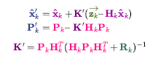
What’s been done since
Kalman filter update step
Omp (gcc, icc, pgi)
Tbb(gcc, icc)
Alpaka(gcc, icc, nvcc)
Eigen(gcc, icc, nvcc)
Kokkos
Mkl
Omp4
Acc
Cuda (unified and explicit)
Added/ adjusted tools for simple comparisons and scaling tests
Parameters
X: predicted new track parameters
(x, y, z, pt, phi, theta)
Z: hit info
(x, y,z)
P: track covariance
R: Hit covariance
H: 3x3 identity matrix embedded in 3x6 matrix
(1,0,0,0,0,0)
(0,1,0,0,0,0)
(0,0,1,0,0,0)
So HX -> Z

Slide 4
What still needs to be done
Fixing GPU timing comparisons
Full region time (not computation + memory transfer times)
Mem transfer and computation time from profiling tools
Memory transfers inside of iterations
Cuda
Cuda 2
Alpaka
Eigen
Acc
Kokkos
Timing goes from ~0.5 s total to ~5-15 s total
Room for improvement: overlapping mem transfers
Place Kokkos and MKL into main repository
Switch to throughput measurements
Region time/ (NITER*evt*tracks)
NITER not previously included
Scaling tests/ optimal parameters
Number of threads/ streams
Matriplex size (bsize)
# events
# tracks
# iterations?
Profiling
Overlap memory transfers with computation
Test on other architectures
CS paper

Slide 5
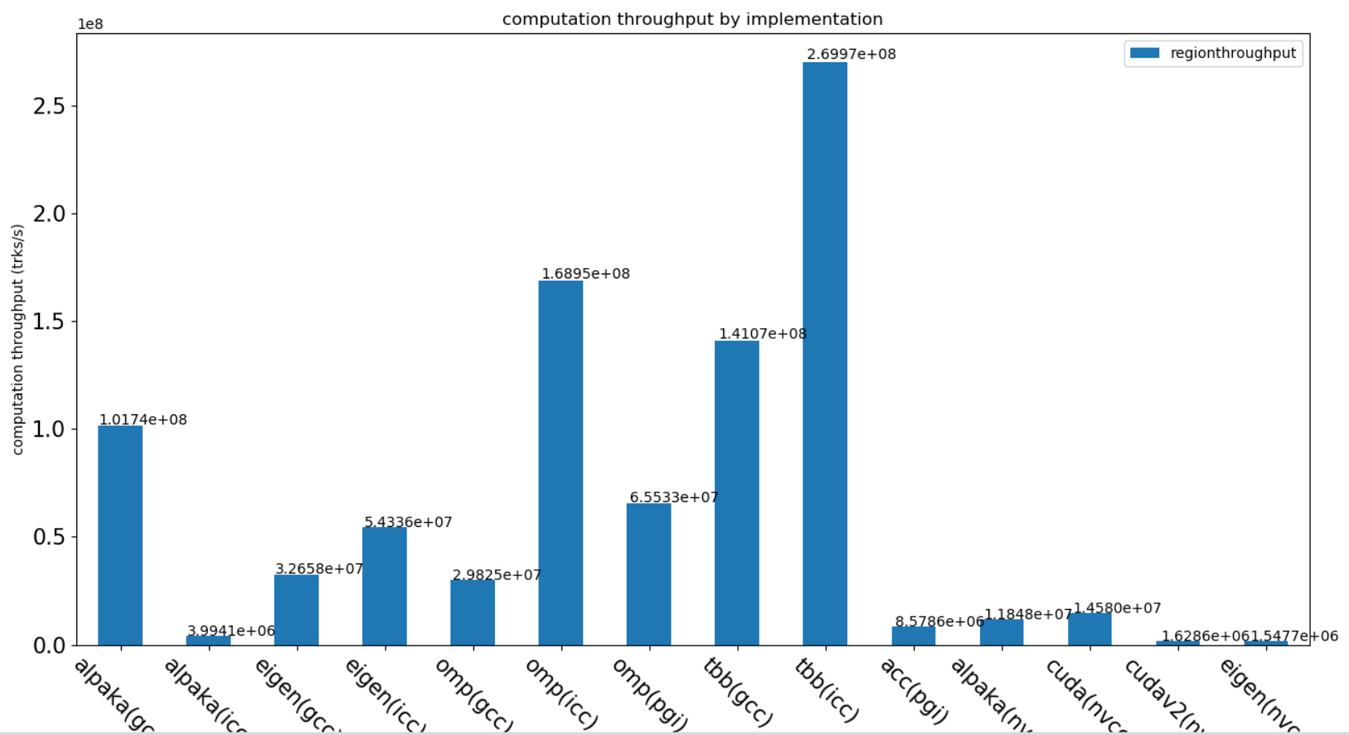
Current Comparisons
Note:
This is now the throughput for the full region time
(higher is better, should be fair between gpu and cpu)
NITER*evt*trk/ region time

Slide 6
backup
OMP4 also done but takes a long time to run

Slide 7
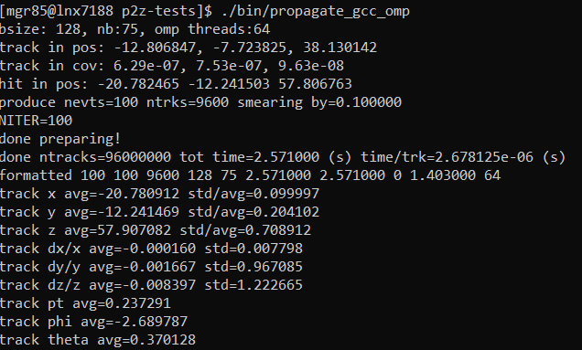
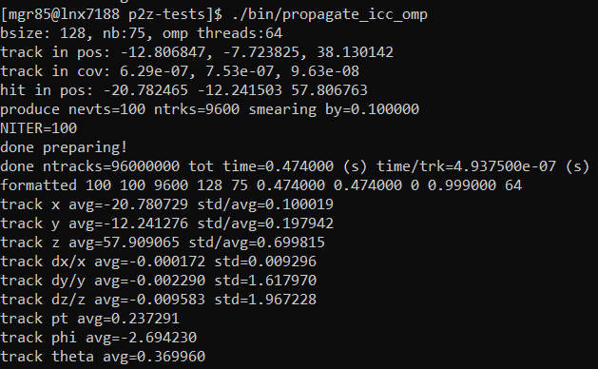
OMP CPU

Slide 8
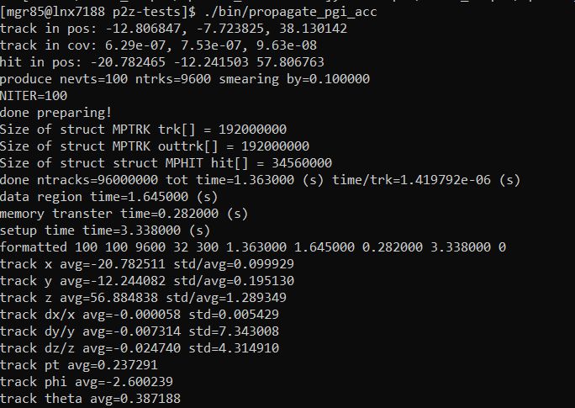

OMP and ACC (PGI)

Slide 9
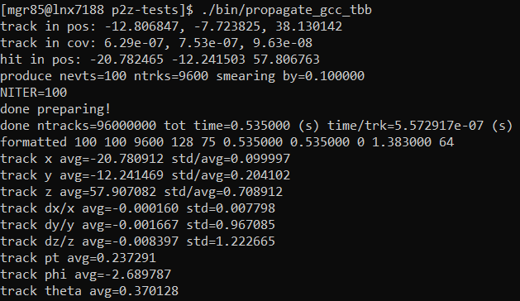

TBB

Slide 10
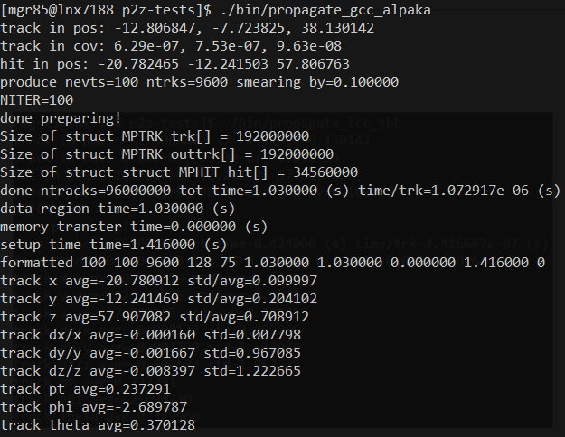
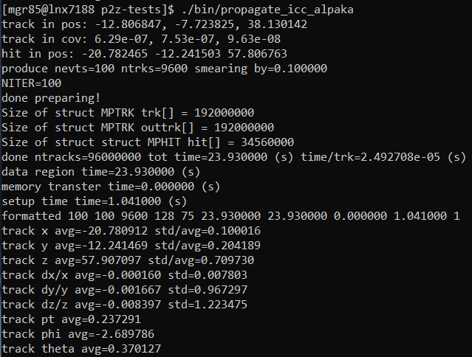
Alpaka CPU

Slide 11
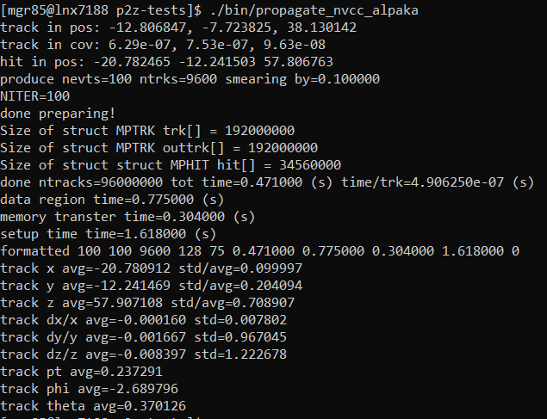
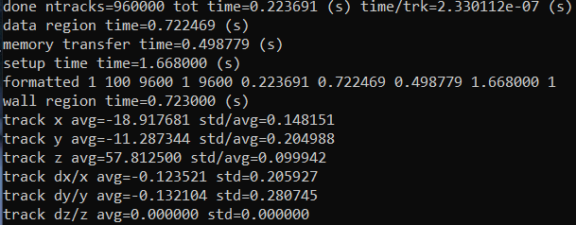
Alpaka and Eigen GPU
Eigen nvcc (not done)

Slide 12
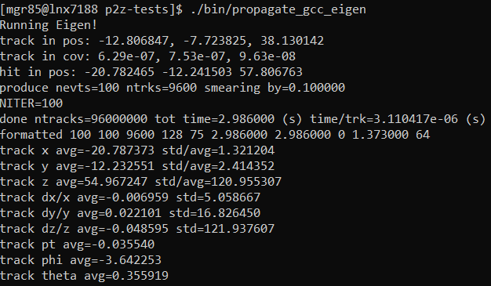
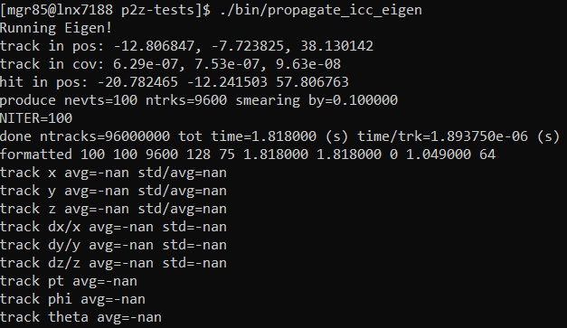
Eigen cpu

Slide 13
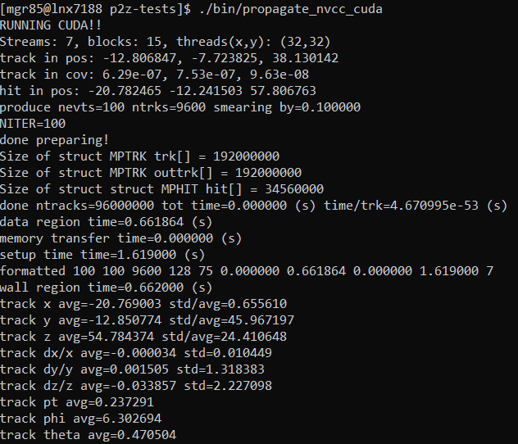
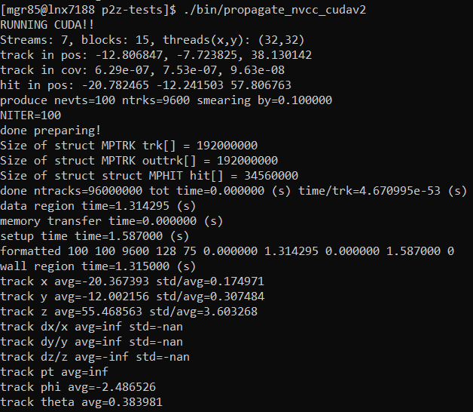
Cuda (unified vs explicit)

Slide 14
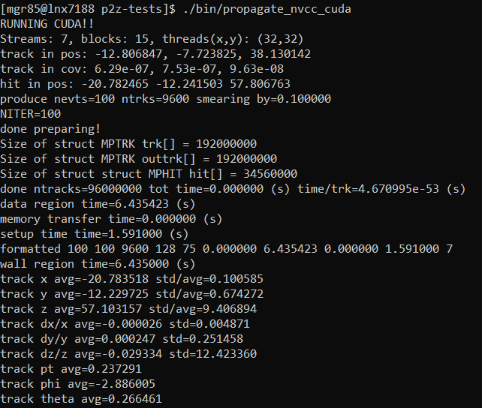

Cuda mem itr

Slide 15
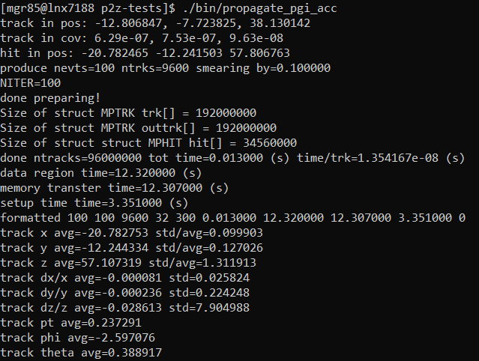
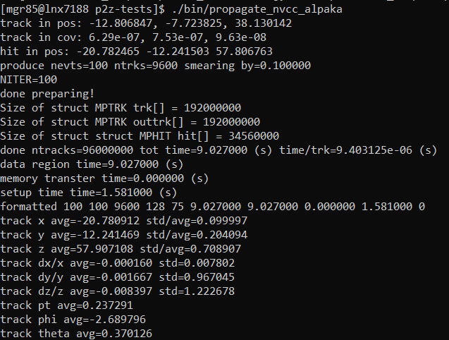
ACC/ alpaca mem itr

